Slide 1
REGULAR EXPRESSIONS FOR REAL-WORLD TEXT PROCESSING
SIMATS ENGINEERING Saveetha Institute of Medical and Technical Sciences Chennai-602105.
DSA0302 - Natural Language Processing
Supervisor
DR.T.DEVI,
SIMATS Engineering
Presented By
M.SIVA ANJANEYULU
REG NO :192424419

Slide 2
INTRODUCTION
Regular Expressions (Regex) are sequences of characters used to define search patterns.
They help search, match, extract, and replace text efficiently.
Regex is supported by programming languages like Python, Java, JavaScript, and C#.
It is widely used in text processing and data validation.
Regex reduces manual effort and improves accuracy

Slide 3
Data Validation Using Regular Expressions
Data validation is the process of checking whether input data follows a required format.
Regular Expressions (Regex) verify data before it is accepted or stored.
They help prevent invalid, incomplete, or incorrectly formatted input.
Regex ensures data consistency, accuracy, and reliability.
Common Validation Examples
Email Address – student@example.com
Phone Number – 9876543210
Password Strength – Minimum length with letters, numbers, and special characters
Student ID / Register Number – Matches the required institutional format
Date Format – DD/MM/YYYY or YYYY-MM-DD

Slide 4
Real-World Applications of Regular Expressions
Resume information extraction
Email and phone number validation
Password strength verification
Product search using keywords
Log file analysis
Data cleaning and preprocessing
Web scraping and text mining Form input validation

Slide 5
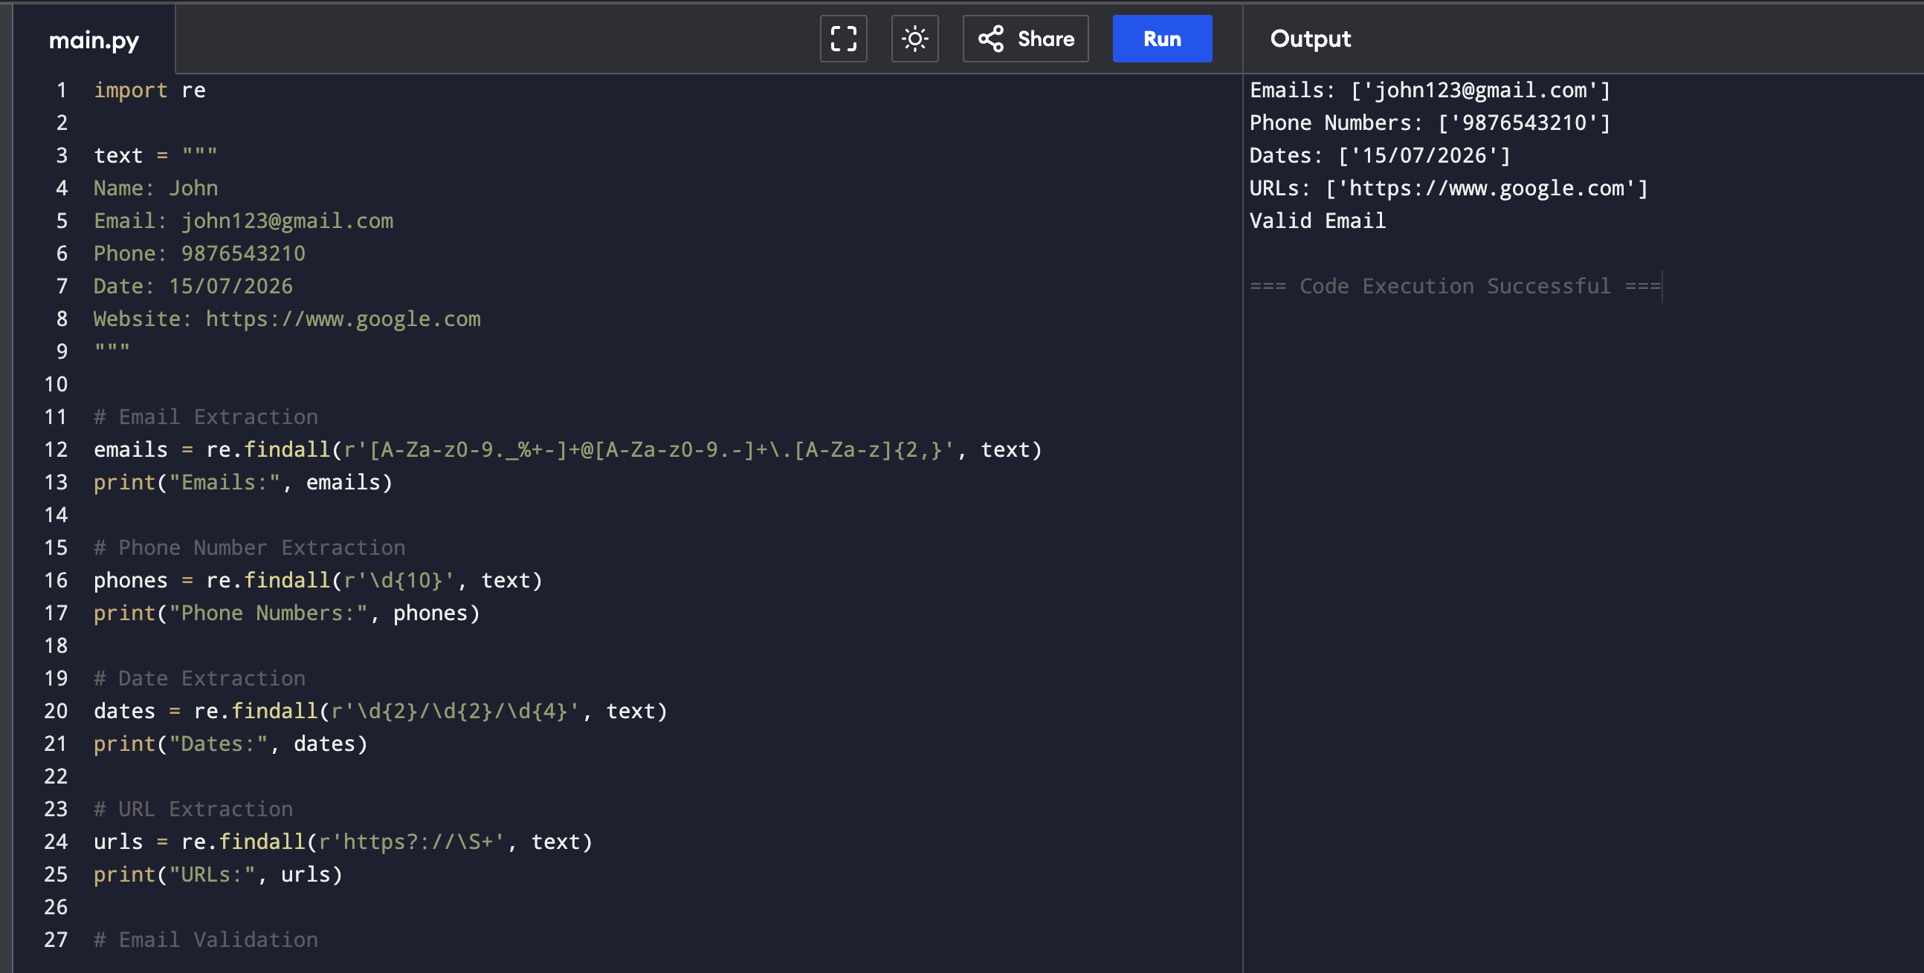
Implementation with Examples
import re
email = "student123@gmail.com"
pattern = r'^[A-Za-z0-9._%+-]+@[A-Za-z0-9.-]+\.[A-Za-z]{2,}$'
if re.match(pattern, email):
print("Valid Email")
else:
print("Invalid Email")
Output :
Valid Email

Slide 6
Advantages and Limitations of Regular Expressions
Advantages:
Fast and efficient for searching and matching text patterns.
Simplifies complex text-processing tasks.
Validates user input such as emails, phone numbers, and passwords.
Limitations:
Complex regex patterns can be difficult to read and understand.
Debugging long expressions can be challenging.
Poorly designed regex may reduce performance on large datasets.

Slide 7
Conclusion and Future Scope
Conclusion
Regular Expressions are powerful tools for text processing and pattern matching.
They automate validation, extraction, and searching tasks.
Regex improves efficiency, accuracy, and productivity in software applications.
Future Scope
AI-powered text processing.
Natural Language Processing (NLP).
Big Data analytics.
Advanced cybersecurity applications.
Intelligent document processing and automation.

Slide 8


